Slide 1
Real-time Global Illumination
Introduction to a voxel-based hybrid method
Che Sun

Slide 2
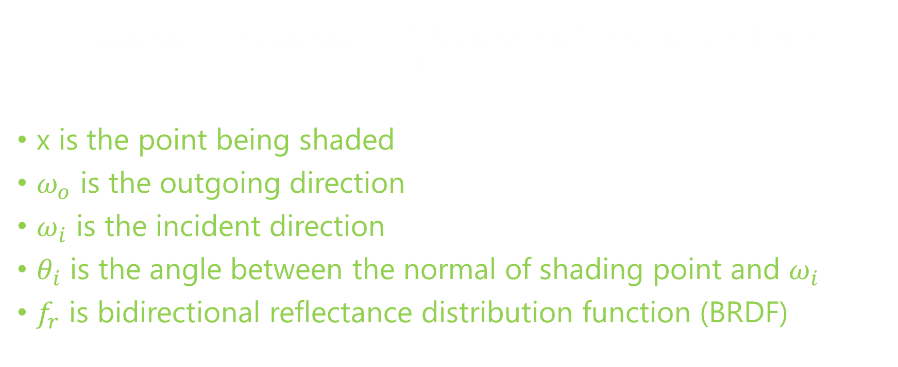
The Rendering Equation
$$L_{o}\left(x, ω_{o}\right)=L_{e}\left(x, ω_{o}\right)+ \int_{Ω}^{ }{f_{r}\left(x, ω_{i}, ω_{o}\right)L_{i}(x, ω_{i})\cos{θ_{i}}}ⅆω_{i}$$
x is the point being shaded
$ω_{o}$ is the outgoing direction
$ω_{i}$ is the incident direction
$θ_{i}$ is the angle between the normal of shading point and $ω_{i}$
$f_{r}$ is bidirectional reflectance distribution function (BRDF)

Slide 3

Monte Carlo Integration
A technique for numerical integration using random numbers
Monte Carlo Estimator
$$L_{o}\left(x, ω_{o}\right) ≈L_{e}+I=L_{e}+\frac{1}{N} \sum_{i=1}^{N}{\frac{f\left(x_{i}\right)}{p(x_{i})}}$$
$f\left(x\right)$ is integrand function
$p\left(x\right)$ is probability density function (PDF) of $f\left(x\right)$

Slide 4
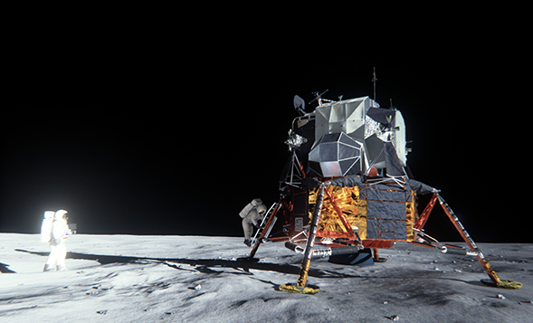
State-of-the-art
Real-time Monte Carlo Methods
Many-light based method
Voxelization based method
Image-space based method
Real-time Partial Differential Equation (PDE) based Method
Numerical PDE solver of diffusion equation

Slide 5
A Novel Voxel-based Hybrid Method
Based on …
Tokuyoshi, Yusuke, and Shinji Ogaki. "Real-time bidirectional path tracing via rasterization." Proceedings of the ACM SIGGRAPH Symposium on Interactive 3D Graphics and Games. ACM, 2012.
Thiedemann, Sinje, et al. "Voxel-based global illumination." Symposium on Interactive 3D Graphics and Games. ACM, 2011.
Crassin, Cyril, et al. "Interactive indirect illumination using voxel cone tracing." Computer Graphics Forum. Vol. 30. No. 7. Blackwell Publishing Ltd, 2011.

Slide 6
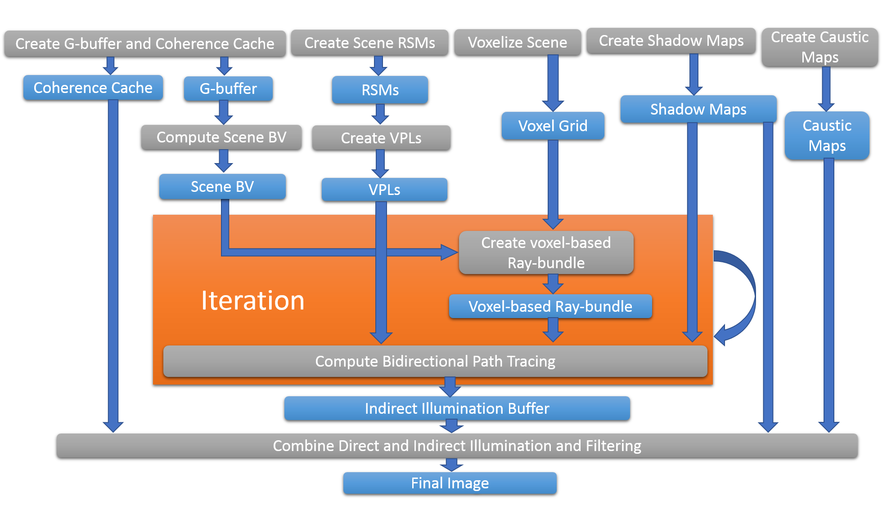
System Overview
Data
Algorithm

Slide 7
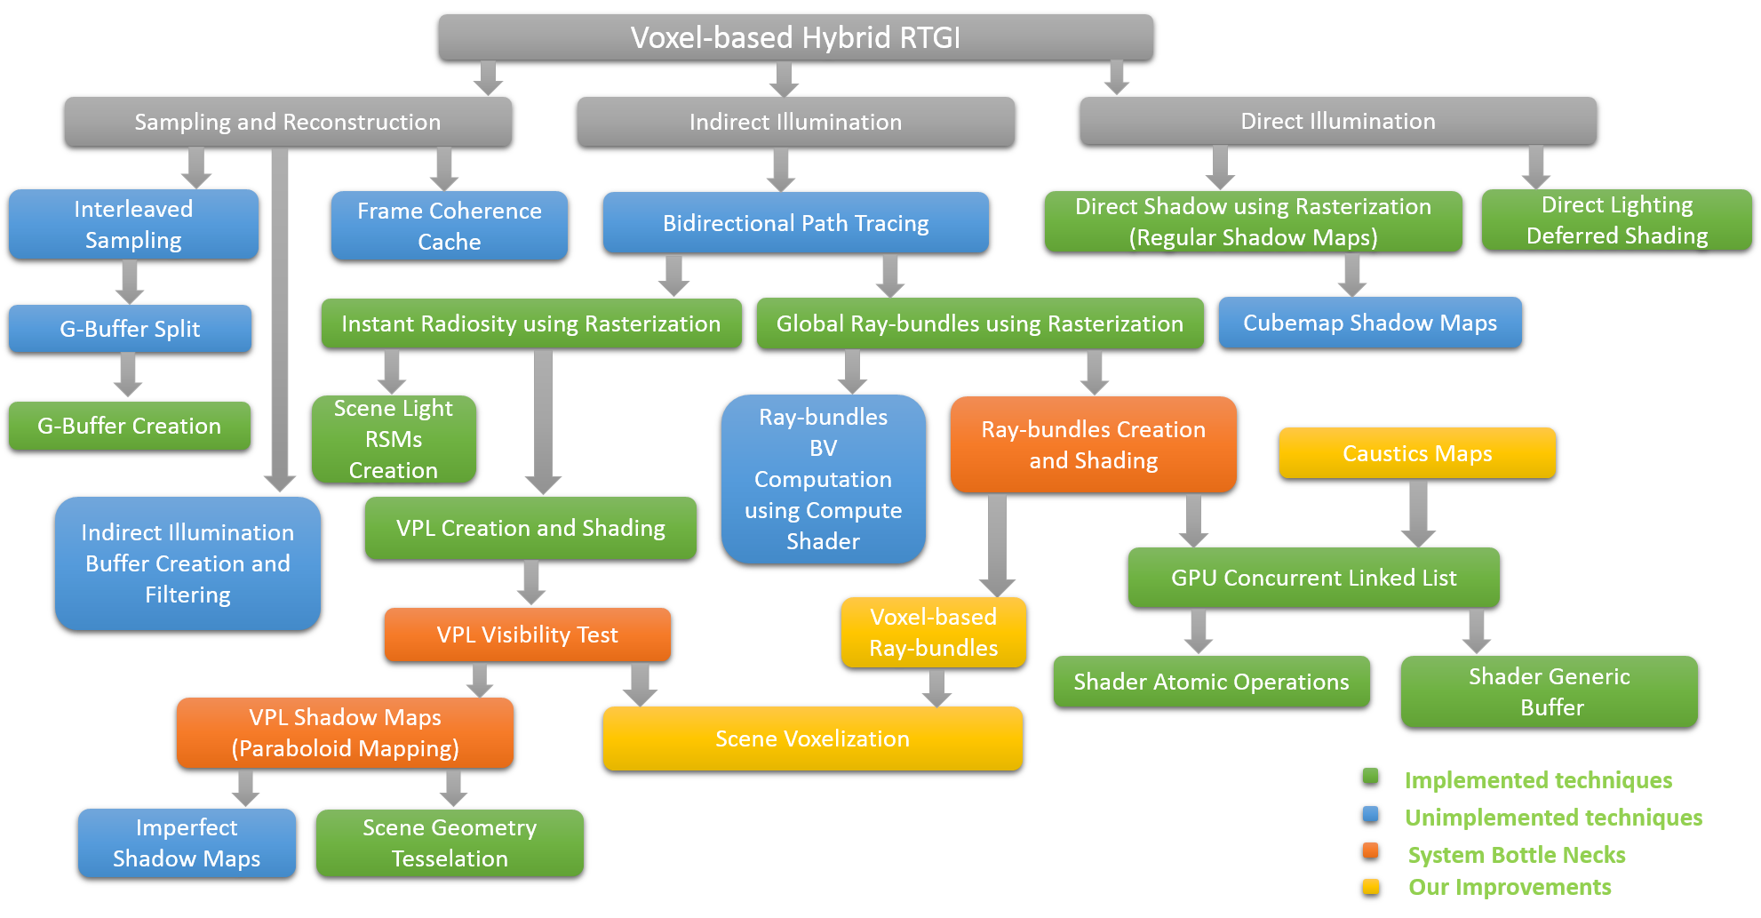
Technique Dependency

Slide 8
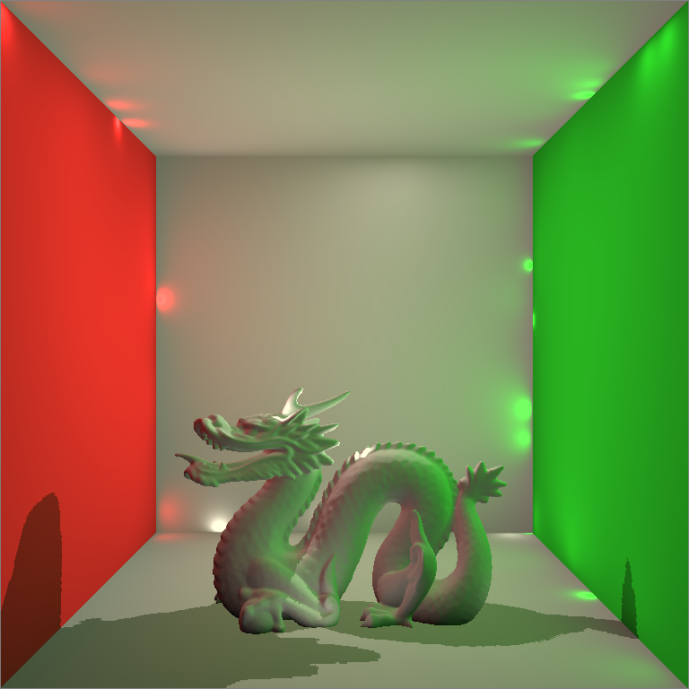
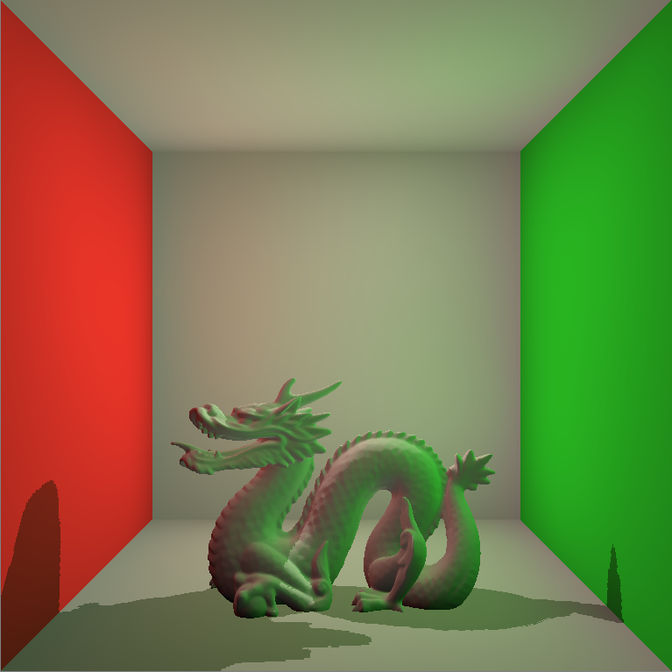
Real-time Virtual Point Lights Rendering
Naïve Implementation of Instant Radiosity
Depends on VPL Shadow Maps (Very slow!)
Classic Singularity Issue

Slide 9
Resolving the Singularity Issue by Clamping
Code Fragment
vec3 indirectColor = vec3(0.0, 0.0, 0.0);
for( int i = 0; i < VPLCount; ++i )
{
VPL vpl = VPLBuffer.vpls[i];
vpl.WorldNormal = vpl.WorldNormal*2.0 - 1.0;
vec3 incidentDir = PositionWorld.xyz - vpl.WorldPosition.xyz;
float len = length(incidentDir);
incidentDir = incidentDir / len;
float cos0 = max(0.0, dot(NormalWorld, -incidentDir));
float cos1 = max(0.0, dot(incidentDir, vpl.WorldNormal.xyz));
float geometricTerm = cos0 * cos1 / max(len*len, BounceSingularity);
indirectColor += MaterialColor.rgb * vpl.Flux.rgb * geometricTerm;
}
indirectColor = indirectColor * 2 * PI;
gl_FragData[0] = vec4(indirectColor, 1.0);

Slide 10
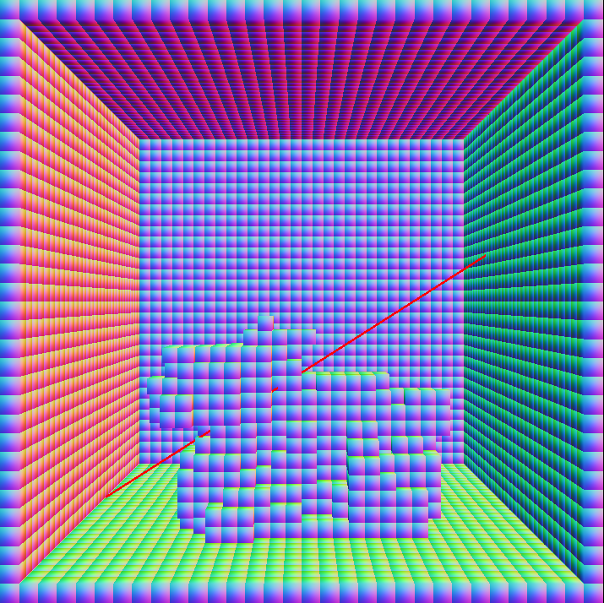
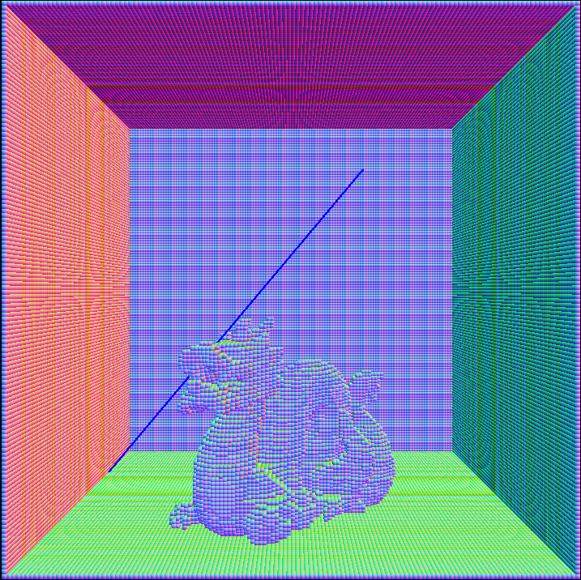
Resolving the VPL Shadow Maps Issue by Voxelization
Visibility Tests by Shadow Maps
Visibility Tests by Voxel Grid

Slide 11
Resolving the VPL Shadow Maps Issue by Voxelization
Code Fragment
AABB bb = GetTriangleAABB(vPositionWorld[0].xyz, vPositionWorld[1].xyz, vPositionWorld[2].xyz);
vec3 bbCenter = GetAABBCenter(bb);
vec3 bbExtension = GetAABBExtension(bb);
vec3 faceNormalWorld = vNormalWorld[0].xyz + vNormalWorld[1].xyz + vNormalWorld[2].xyz;
faceNormalWorld = normalize(faceNormalWorld);
mat3 matXYZ = mat3(X, Y, Z);
vec3 NdXYZ = faceNormalWorld * matXYZ;
float absNdX = abs(NdXYZ.x);
float absNdY = abs(NdXYZ.y);
float absNdZ = abs(NdXYZ.z);
int axis = 0;
if( absNdY > absNdX )
{
axis = 1;
if( absNdZ > absNdY )
{
axis = 2;
}
}

Slide 12
Resolving the VPL Shadow Maps Issue by Voxelization
Code Fragment Continues …
else
{
if( absNdZ > absNdX )
{
axis = 2;
}
}
mat4 ProjView = GetAxisViewProjTransforms(axis, bbCenter, bbExtension);
for( int i = 0; i < gl_in.length(); ++i )
{
gPositionWorld = vPositionWorld[i];
gNormalWorld = vNormalWorld[i];
gl_Position = ProjView * gl_in[i].gl_Position;
EmitVertex();
}
EndPrimitive();

Slide 13
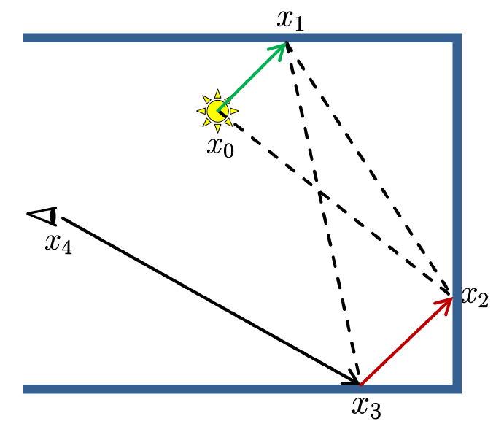
Bidirectional Path Tracing
A Robust Method Resolving the Singularity Issue
Connect the shading path from both
the VPL and Camera
Importance Sampling

Slide 14
Generation of Camera Paths
For each point being shaded, randomly generate N paths
Shooting rays into original scene is slow
Shooting rays into voxel grid is fast
For all points being shaded, randomly generate N paths
Global ray-bundles
Hardware friendly by using GPU rasterizer

Slide 15
Shooting Rays into Voxel Grid
Code Fragment
indirectCommandBuffer.hitSomething = false;
while( true ){
int index = GetIndex(CurPos);
Voxel voxel = voxelBuffer.data[index];
if( voxel.hasGeometry )
{
indirectCommandBuffer.hitSomething = true;
break;
}
// Advance to next voxel.
int c1 = int(NextCrossingT[0] < NextCrossingT[1]);
int c2 = int(NextCrossingT[0] < NextCrossingT[2]);
int c3 = int(NextCrossingT[1] < NextCrossingT[2]);
int bits = (c1 << 2) + (c2 << 1) + c3;
int stepAxis = cmpToAxis[bits];
CurPos[stepAxis] += Step[stepAxis];
if( CurPos[stepAxis] == EndPos[stepAxis] )
{
break;
}
NextCrossingT[stepAxis] += DeltaT[stepAxis];
}

Slide 16
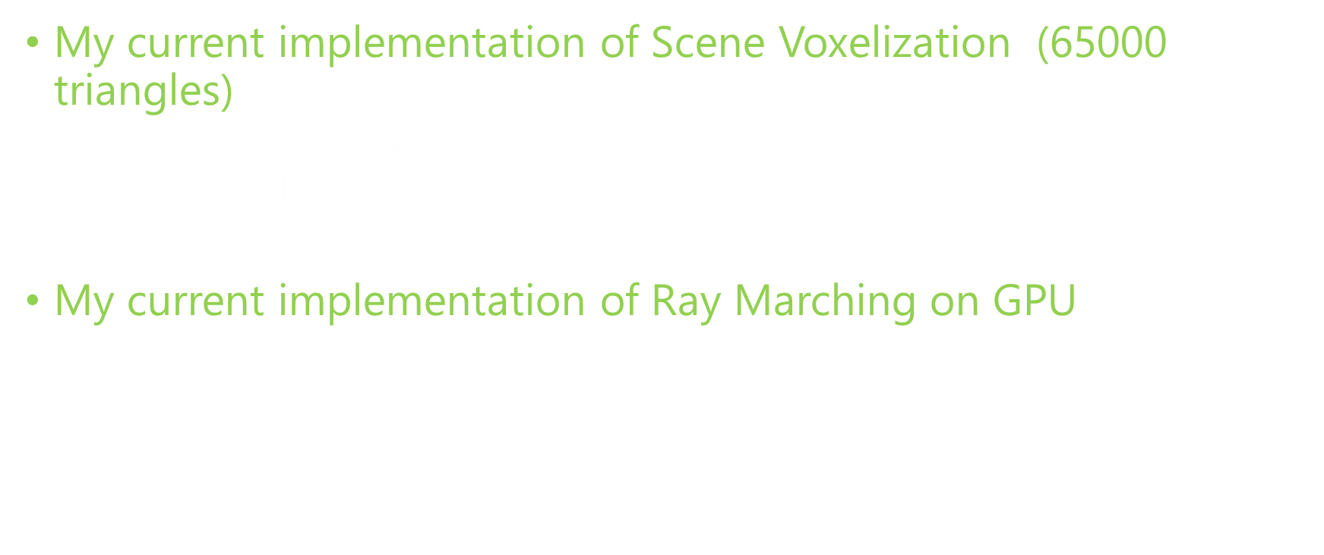
Performance of Voxel-based technique
My current implementation of Scene Voxelization (65000 triangles)
${64}^{3}$ voxel grid (1.48 ms)
${128}^{3}$ voxel grid (2.8 ms)
My current implementation of Ray Marching on GPU
Running on compute shader, marching a ray through voxel grid (0.02 ms)

Slide 17
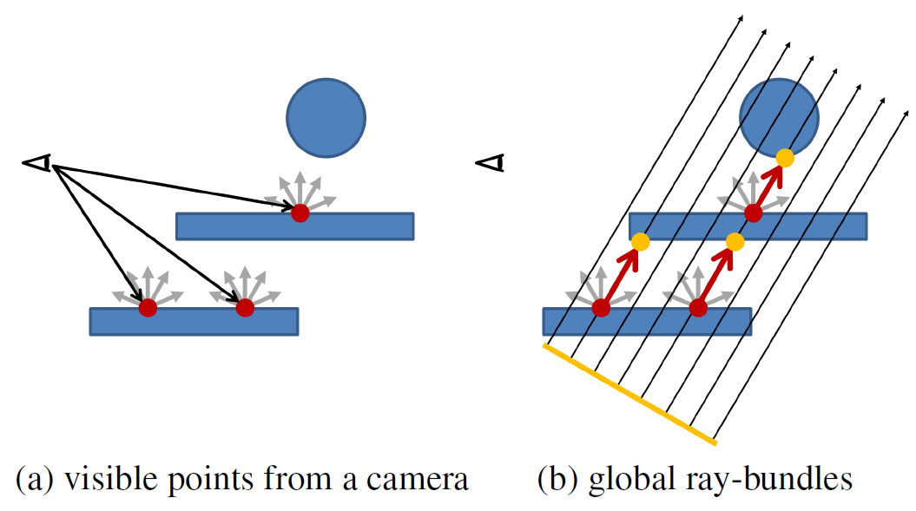
Real-time Global Ray-bundles
Rasterization of Original Scene (Slow)
Rasterization of Point-based Scene (Fast)

Slide 18
Generation of Light Paths
Quasi-Monte Carlo Random Walk
Ground truth but slow
Keller, Alexander. "Instant radiosity." Proceedings of the 24th annual conference on Computer graphics and interactive techniques. ACM Press/Addison-Wesley Publishing Co., 1997.
Reflective Shadow Maps
Approximation but fast
Dachsbacher, Carsten, and Marc Stamminger. "Reflective shadow maps." Proceedings of the 2005 symposium on Interactive 3D graphics and games. ACM, 2005.

Slide 19
Advanced Shader Programming via Shader Model 5.0
OpenGL 4.3 Specification
Shaders
Vertex Shader
Tesselation Control Shader
Tesselation Evaluation Shader
Geometry Shader
Fragment Shader
Compute Shader
Improved GPU Memory Programming Model
Shader Atomic Operations
GPU Memory Random Access Model (Structured Buffer)
Avoid CPU-GPU Interaction
Indirect Command Buffer

Slide 20
Example 1 (Building Per-pixel Linked List on GPU)
layout (binding = 0, offset = 0) uniform atomic_uint gpuMemoryAllocator;
layout (binding = 0, r32ui) uniform uimage2D headPointerImage;
layout (std430, binding = 0) buffer gpuMemoryPool2
{
ListNode nodes[];
}outBuffer;
void main()
{
vec3 vNormal = normalize(vNormalView.xyz);
vNormal.xyz = (vNormal.xyz + 1.0) * 0.5;
vec4 newNodeData = vec4(vNormal, 0.5);
uint newHead = atomicCounterIncrement(gpuMemoryAllocator);
uint oldHead = imageAtomicExchange(headPointerImage, ivec2(gl_FragCoord.xy), newHead);
ListNode newNode;
newNode.next = oldHead;
newNode.data = newNodeData;
newNode.depth = vPositionView.z;
outBuffer.nodes[newHead] = newNode;
gl_FragData[0] = vec4(vNormal, 0.0);
}

Slide 21
Example 2 (Gathering Voxels)
layout(std430, binding = 1) buffer _indirectCommandBuffer {
uint count, primCount, firstIndex, baseVertex, baseInstance;
GatheredVoxel data[];
} indirectCommandBuffer;
layout(binding = 0, offset = 0) uniform atomic_uint gpuMemoryAllocator;
uniform vec3 SceneBBMin, vec3 SceneBBExtension;
void main() {
int index = int(gl_GlobalInvocationID.z * gl_NumWorkGroups.y * gl_NumWorkGroups.x * LOCAL_GROUP_DIM * LOCAL_GROUP_DIM +
gl_GlobalInvocationID.y * gl_NumWorkGroups.x * LOCAL_GROUP_DIM + gl_GlobalInvocationID.x);
vec3 voxelSize = 2.0*SceneBBExtension / vec3(gl_NumWorkGroups * LOCAL_GROUP_DIM);
vec3 voxelWorldPosition = SceneBBMin + vec3(gl_GlobalInvocationID)*voxelSize + 0.5*voxelSize;
if( index == 0 ) {
indirectCommandBuffer.primCount = 0;
}
memoryBarrier();
if( voxelBuffer.data[index].value2 > 0 ) {
uint newLocation = atomicCounterIncrement(gpuMemoryAllocator);
GatheredVoxel data;
data.translation = vec4(voxelWorldPosition, 1.0);
indirectCommandBuffer.data[newLocation] = data;
atomicAdd(indirectCommandBuffer.primCount, 1);
}
}

Slide 22
Thank You!
Any Questions?

